Slide 1
Team 5 project Proposal
Dillon Williams, Ryan Reed, Austin Sigg, Nidhay Patel, Michel turpeau

Slide 2
Project Overview
nidhay

Slide 3
Specifications
Trays shall be 10in wide and 10in long
Communication shall be by ethernet
Shall have a database to hold information
Shall have nonvolatile memory To account for power loss
The machine shall direct the student to the board using LEDs
Shall have locks that are not easily broken
Constraints:
Boxes shall have the barcode scanned before dispensing
Shall have an eagle card reader to identify students
Must be window height to be easily portable

Slide 4
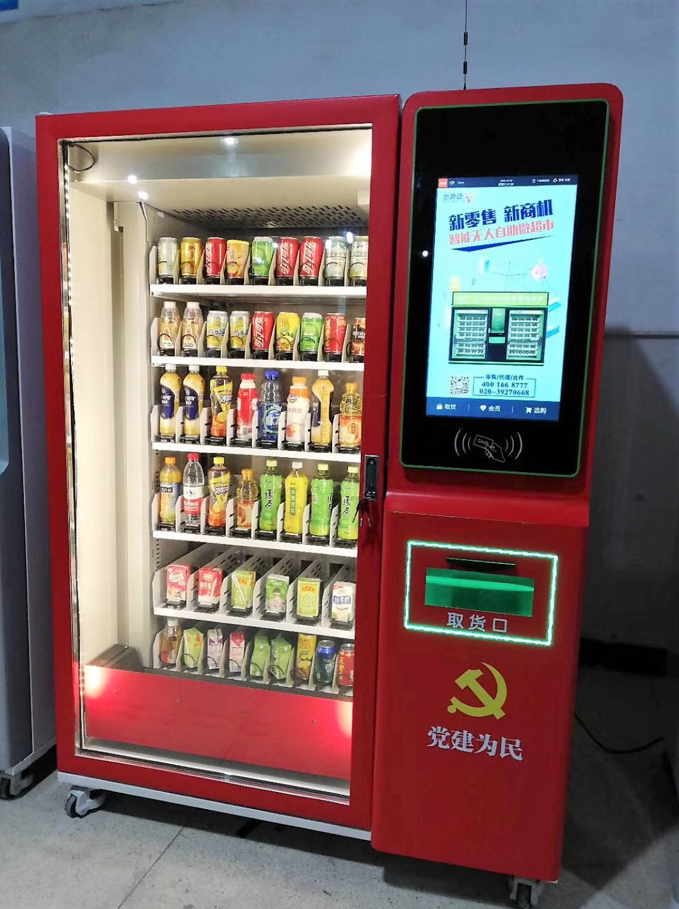
Existing Solutions
Elevator Vending Machine
PROS:
Safety of Devices
Decent Inventory
CONS:
Shelf Customization Decreases Inventory
Machine Size (6’4”H x 4’7”L x 3’3”W)
PRICE:
Unknown, but generally > $3500

Slide 5
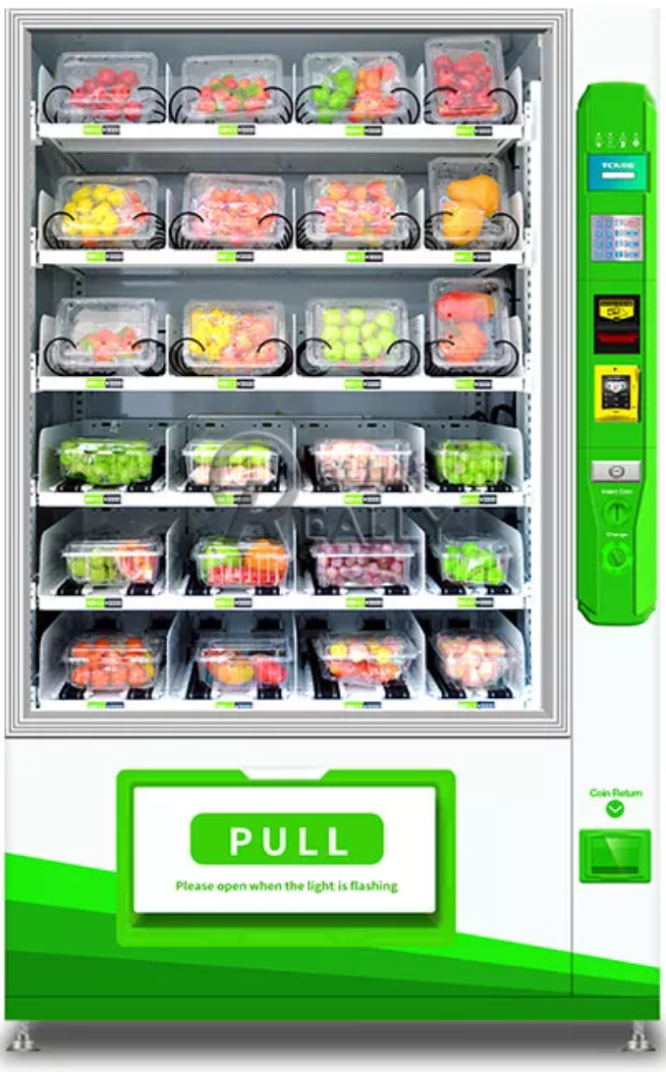
Existing Solutions
Smart Vending Machine
PROS:
Convenience is its Priority
No Buttons = Less Jams
CONS:
Low Safety for Higher Shelves
Maintenance and Repairs
Size as well (6’3”H x 3’10”L x 2’10”)
PRICE:
$2000 - $2350, some can reach $7000

Slide 6
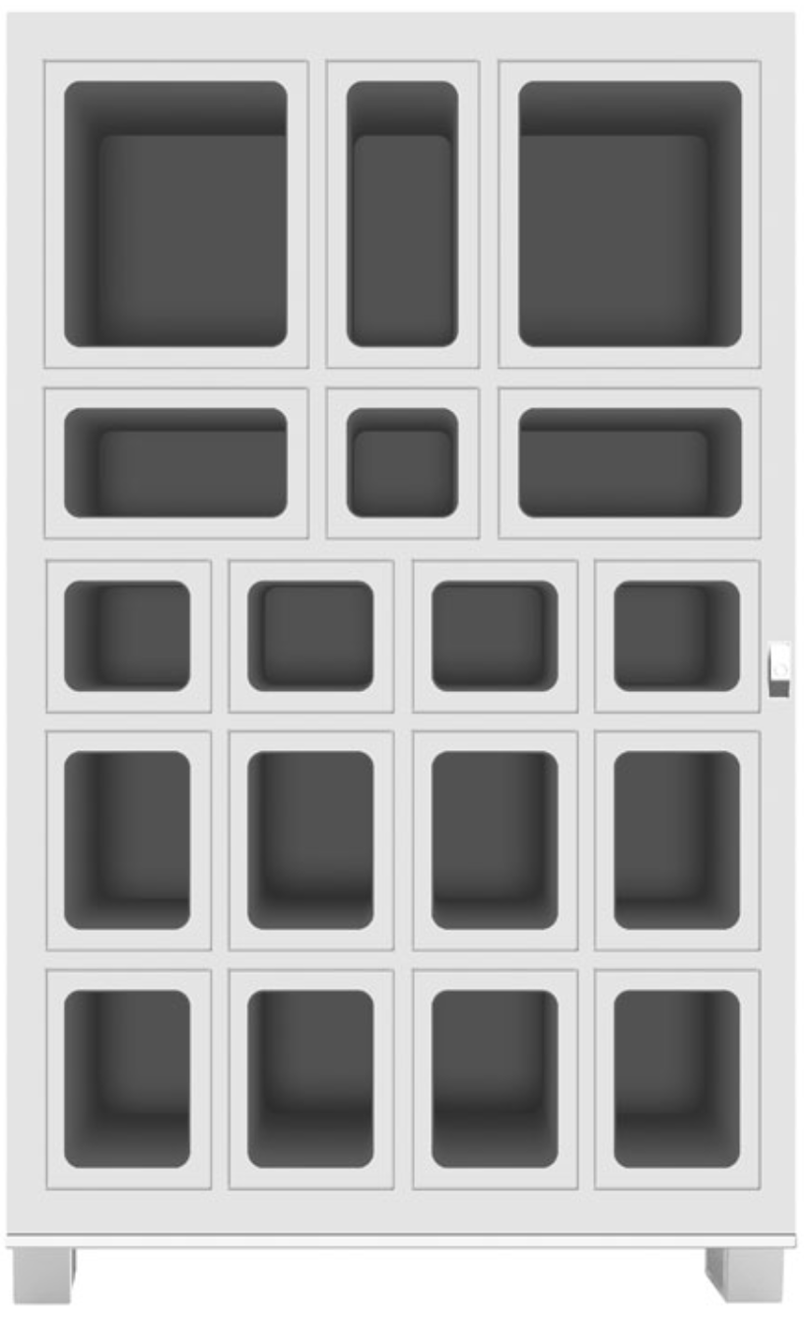
Existing Solutions
Lockerbox Array
PROS:
Various Sized Boxes
Locks for each device
CONS:
Storage / Refilling
Locks must have Strong Resistance
Price:
Unknown, generally

Slide 7
Proposed Solution
Systems:
PLC/Microcontroller
Database
Electronics Control
LED Indication
Power (120 Watt)
Motors
Locks
Ethernet
Communication
Microcomputer
Interface
Critical Unknowns:
Card Reader
What’s on the card?
Can we access it?
Will the Eagle Card Office greenlight the card reader?

Slide 8
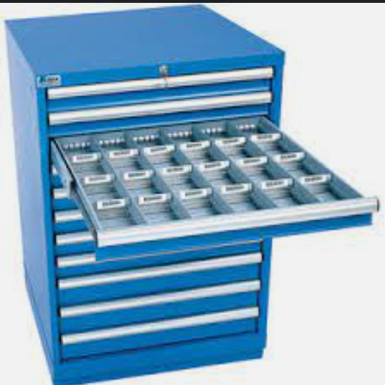
Proposed Solution
“Fastenal Drawer Cabinet” style from Mechanical Team
Solenoid Coil Locks on Drawers
Each Drawer will contain ~4 devices
LEDs will indicate which drawer & device is selected
Interface will be on the top

Slide 9
Measures of Success
The System must dispense the requested item with sufficient speed
The System must be intuitive for students
The System must correctly scan and store the device bar codes and student information.

Slide 10
Broader Impacts
The Vending Machine will influence the jobs of those who work in the ECE department
There is Risk of asset loss
Possible Safety breach of Tennessee Tech Data

Slide 11
Resources
Michel - budget, timeline, conclusion area.
Talk about parts, edit the budget bc the new design, and briefly talk over timeline

Slide 12
Timeline and Conclusion
Michel – after you practice, you may not need a timeline if taking too long, just budget talk and parts needed.

Slide 13
Questions?

